Slide 1
PowerLine F Series
Product Presentation

Slide 2
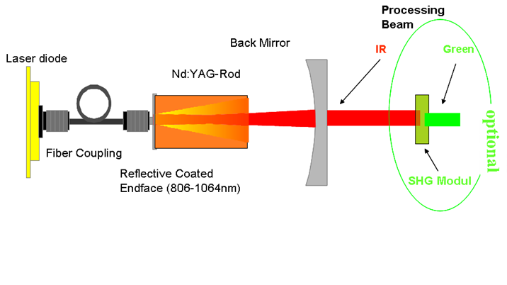
PowerLine F Series
Fiber Lasers – Technology Overview
End-pumped lasers
Fiber lasers
1064 nm, 532 nm, 355 nm
1065 nm
Principle of an end-pumped laser
Principle of a fiber laser

Slide 3
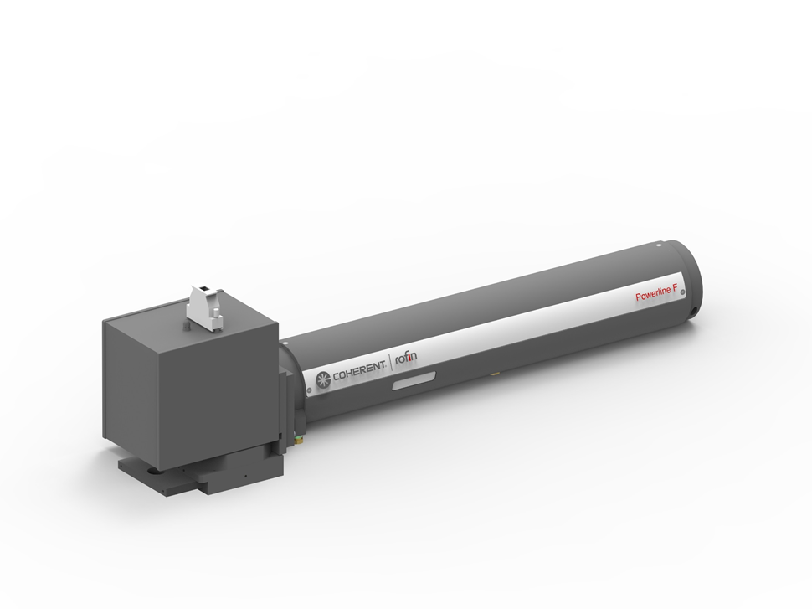
PowerLine F Series PowerLine F 20 / 20 Varia / 30 / 50 / 50 Varia / 100
Features at a glance
Completely air-cooled
Different power ranges
Doubleheader configurations available
Low operating costs

Slide 4
PowerLine F Series
Customer Benefits
Innovative fiber lasers with different power ranges
Single-mode beam quality produces ultra-fine, crisp marks constantly
Fast turn-on time (125 µs) provide highest production throughput
PowerLine F 20 and PowerLine F 30 systems deliver 1 mJ pulse energy with a fast turn-on time and high peak power over a wide range of repetition rates
PowerLine F 20 Varia with adjustable pulse length provides perfect results even with challenging applications (e.g. corrosion-free marking)
PowerLine F 50 / F 50 Varia and F 100 are operated in pulse mode at frequencies up to 200 kHz. The emitted average laser power can be set using the fiber amplifier. Perfectly suitable for high-speed marking.
Single emitter pump diodes enable long lifetime and maintenance free operation

Slide 5
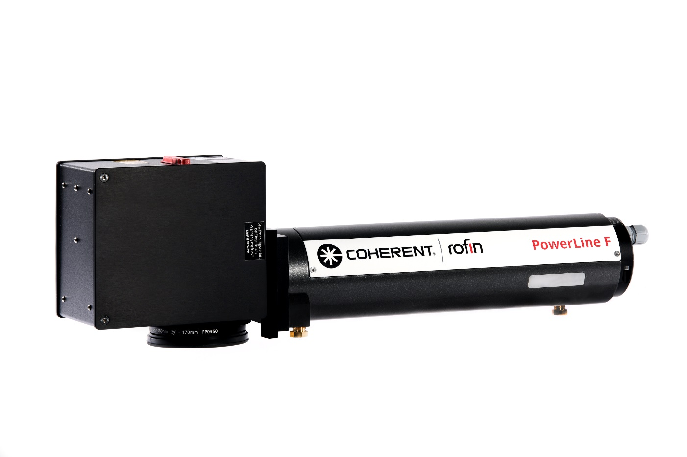
PowerLine F Series
Typical applications
Marking
Engraving
Etching
Trimming

Slide 6
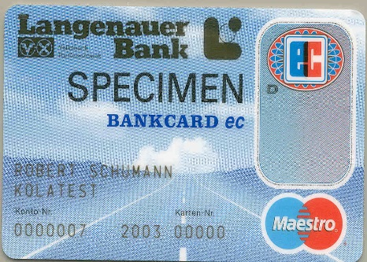
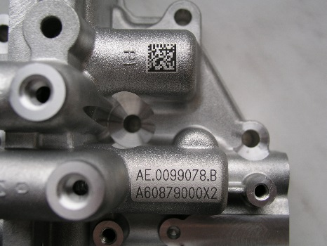
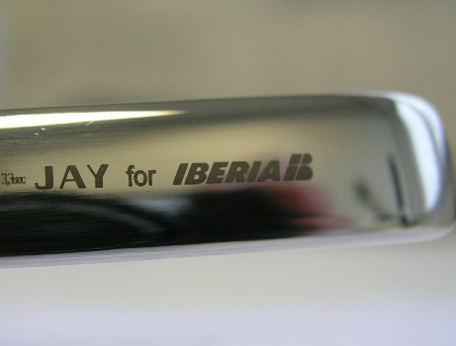
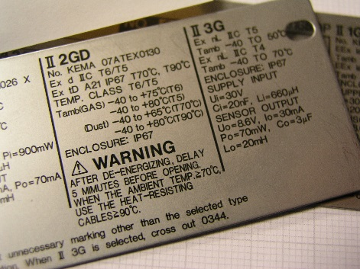
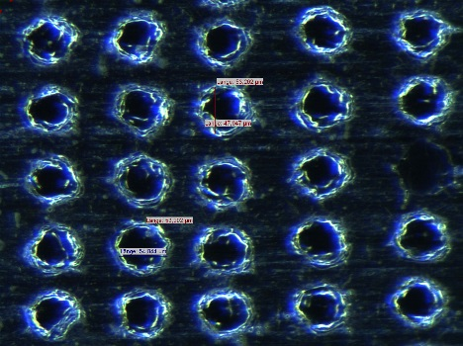
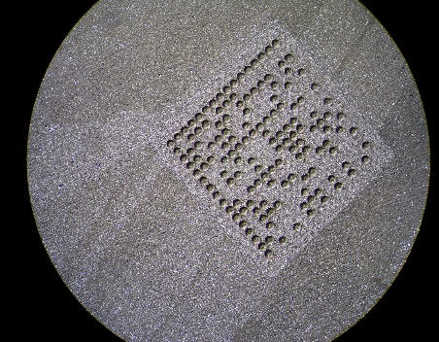
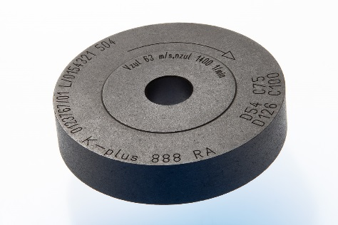
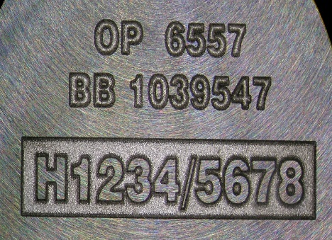
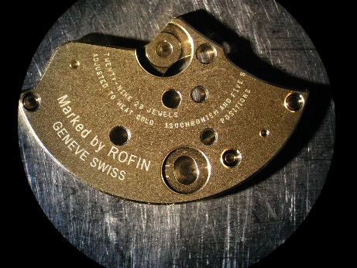
Application Examples
Fraud Safe - Marking of ID Cards
Readability
Annealing
Excellent readability
Aluminum foil backside marking
Traceability - Engraving silicon
Circular marking
No recast cleaning
Nearly cleanness marking in brass

Slide 7
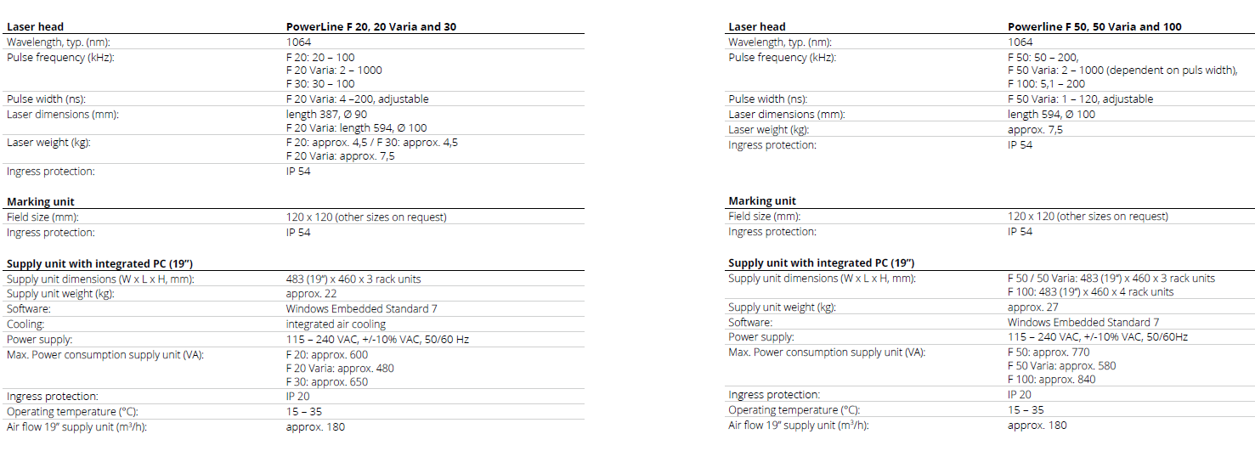
PowerLine F
Technical data

Slide 8
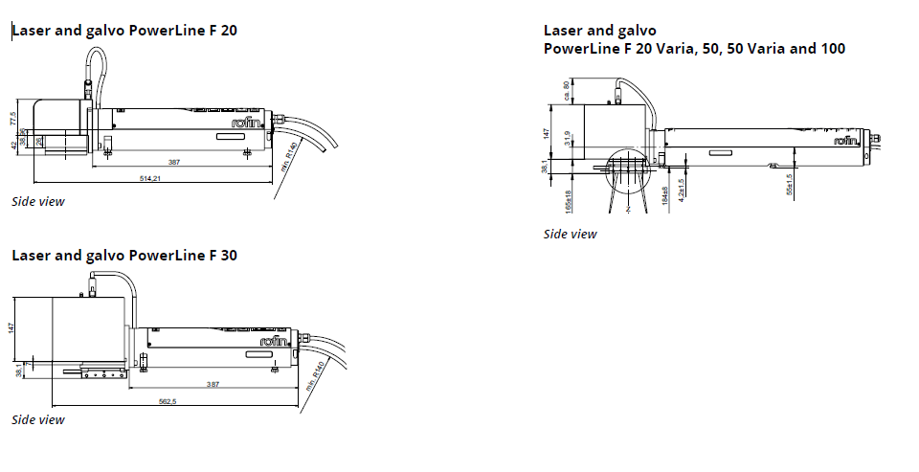
PowerLine F
PowerLine F 20 / 20 Varia / 30 / 50 / 50 Varia / 100

Slide 9
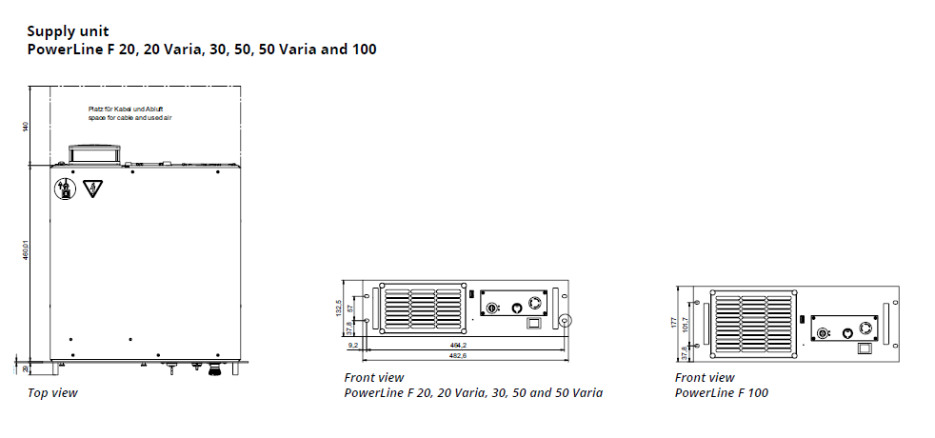
PowerLine F
Supply Unit PowerLine F 20 / 20 Varia / 30 / 50 / 50 Varia / 100

